Slide 1
Exploratory Data Analysis (EDA) Using R

Slide 2
What is exploratory data analysis (EDA)
John W. Tukey wrote the book "Exploratory Data Analysis" in 1977. Tukey held that too much emphasis in statistics was placed on statistical hypothesis testing (confirmatory data analysis); more emphasis needed to be placed on using data to suggest hypotheses to test.
In statistics, exploratory data analysis (EDA) is an approach to analyzing data sets to summarize their main characteristics, often with visual methods.
Notes:
Some definitions of what is EDA.

Slide 3
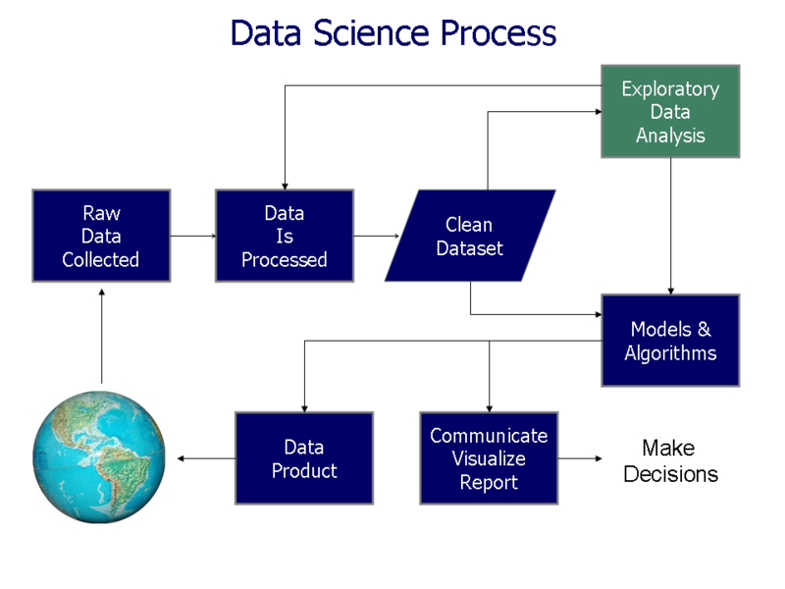
Where does EDA fit in?
Notes:
Steps
Getting the data
Cleaning the data
Figure out what to do next
Exploratory Data Analysis (EDA) helps you to see the “shape” of the data to figure out what are some relationships or clusters of data.
EDA also helps you to identify possible transformations you may need to apply to the data variables (e.g. do you need to log() or exp() the data?).
Do you need to limit the data to exclude some outliers (that are the result of data errors)?
Is data sufficient? If NO, get more data
Form your hypothesis using the findings from EDA
Formulate your hypothesis
Model the data to verify your hypothesis
Is data sufficient? If NO, go back to data gathering
Is data tidy enough for analysis? If NO, go back to data cleaning

Slide 4
EDA objectives
The objectives of EDA are to:
Suggest hypotheses about the causes of observed phenomena
Assess assumptions on which statistical inference will be based
Support the selection of appropriate statistical tools and techniques
Provide a basis for further data collection through surveys or experiments
Notes:
The objectives of EDA.
Mentioned previously:
Forming hypothesis
Identifying if data is enough
Additional
Check your assumptions in forming the hypothesis
Selection of suitable statistical inference tools

Slide 5
EDA objectives
Discover the “shape” or characteristics of your data set
Are there natural “clusters” of data?
Which fields seem to be related or unrelated to each other?
Check your assumptions about the data
There is no valid data more than X-limit?
Provides some clues about “interesting” aspects about your data set that warrants deeper investigation or more data collection
Are there some visible trends (e.g. increase in A is associated with increase in B, or increase in A is associated with decrease in C)
Are there clusters which are not easily separated with a straight line border (leading to need for data transformation)
There seems to be some “gaps” or missing data from your prior data collection
Notes:
Self-explanatory
Expansion of previously stated objectives in the previous slide

Slide 6
Graphical techniques for EDA
Makes use of the human vision capacity to see to see trends
“Humans are good at discerning subtle patterns that are really there, …”
Notes:
EDA focuses on visual techniques to leverage on the capacity of human vision to discern patterns.
People are good at “seeing” things which give a lot of problems to the computer.

Slide 7
Why do we need to know
the “shape” of the data?
Doesn’t statistics tells us everything we need
Notes:
Can statistics “lie”?

Slide 8
There are lies, damned lies and statistics.
Mark Twain
Notes:
A famous quote by author and humourist Mark Twain who wrote The Adventures of Tom Sawyer and it’s sequel Adventures of Huckleberry Finn

Slide 9
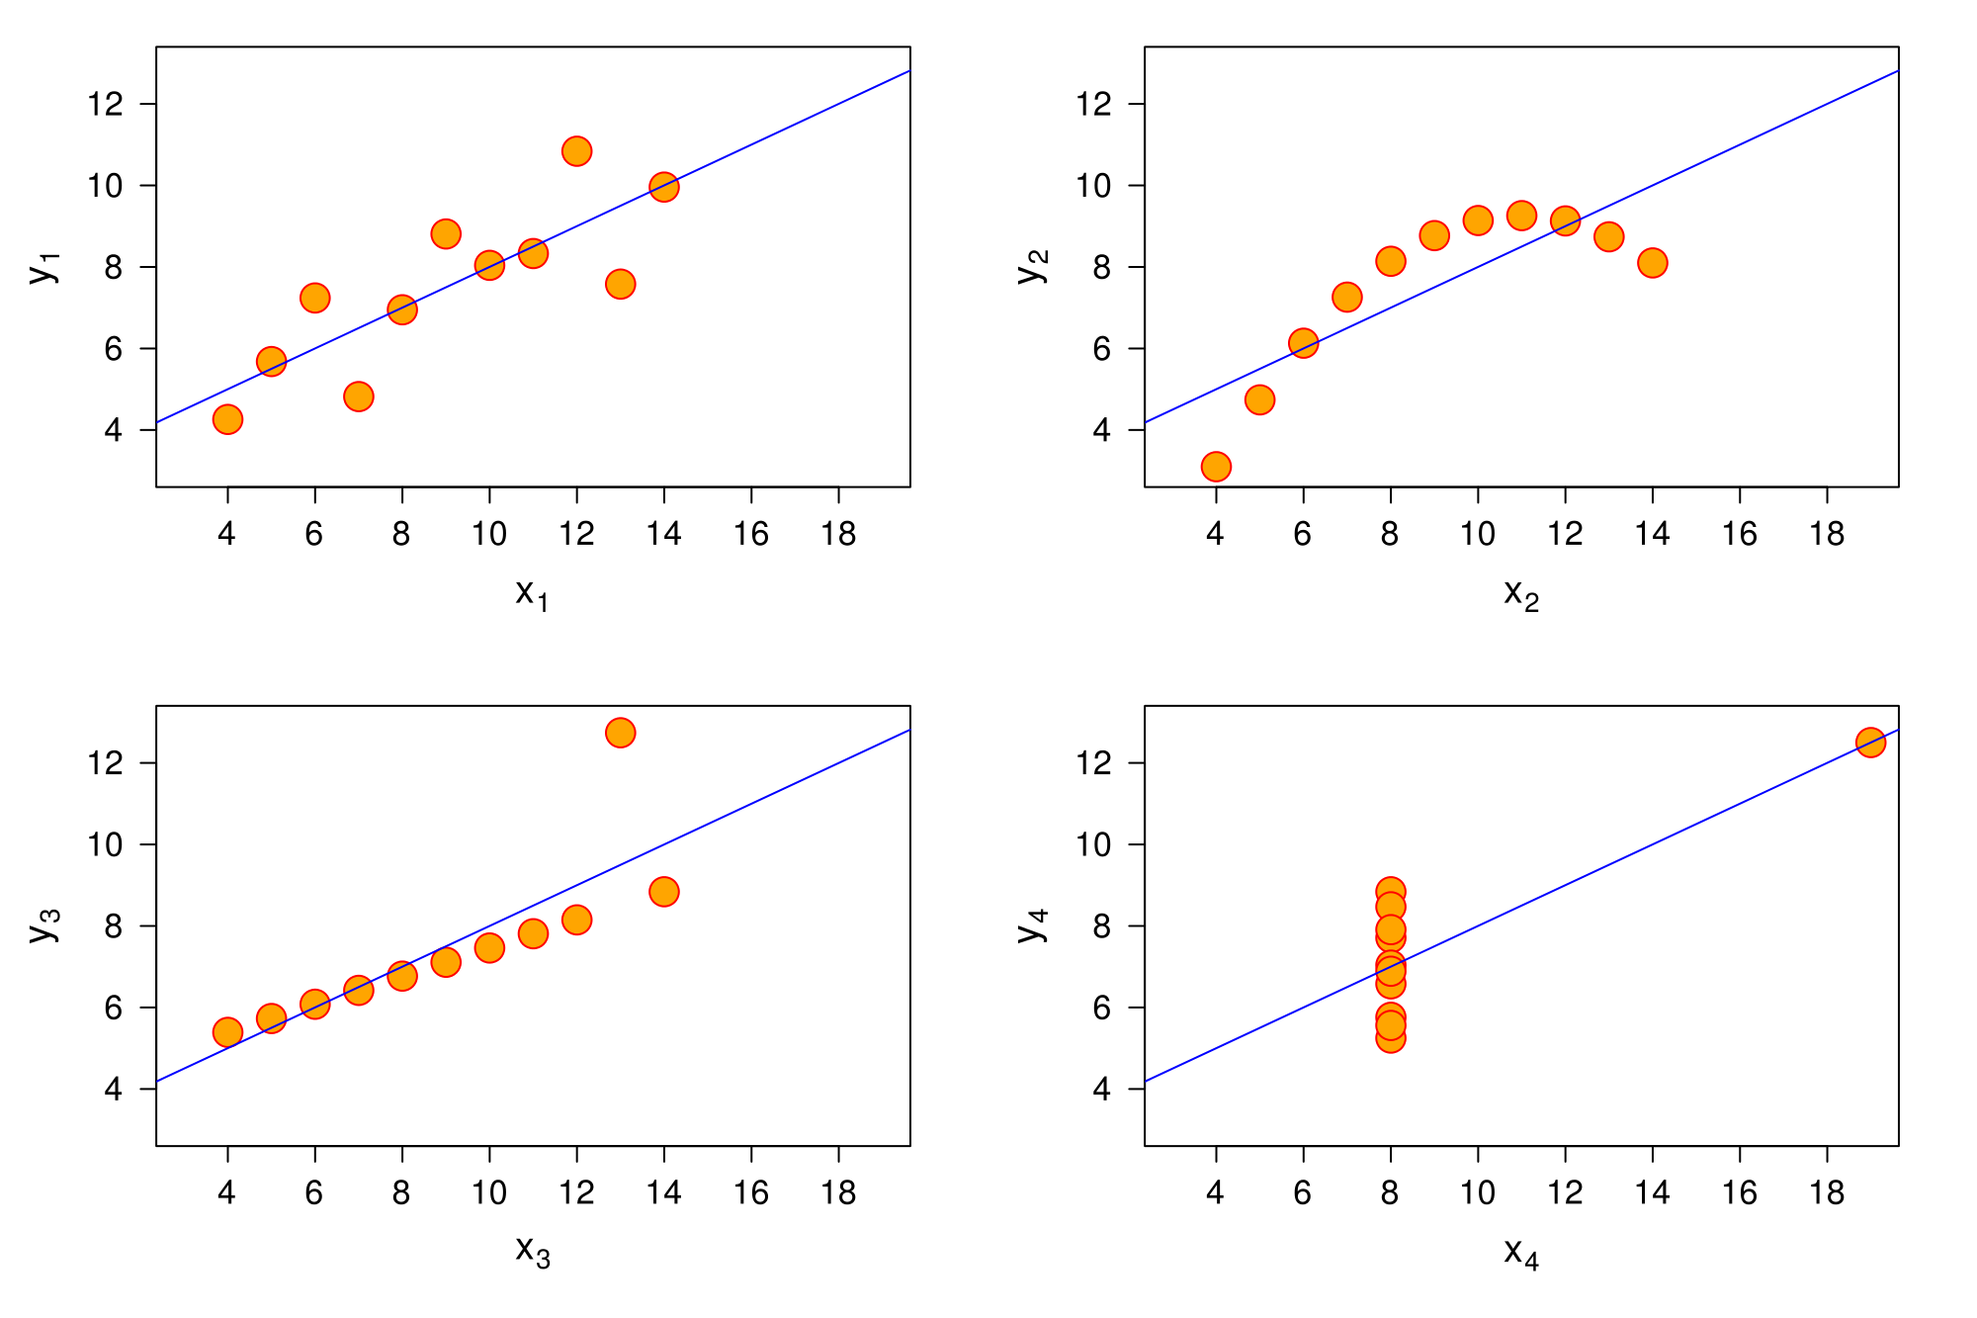
Notes:
Do all these data sets have the same statistics? Yes/No
Are they different sample data sets from the same group/population? Yes/No

Slide 10
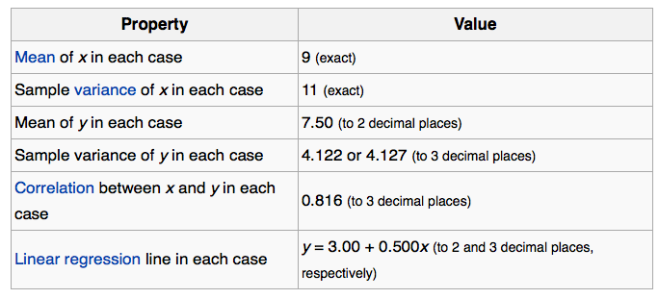
Notes:
Yes, each sample data set actually have the same key statistics.
But, obviously the data are very different despite their identical statistics.
To gather insights, one has to understand statistics and graphs.
Graphs highlight salient features of the data. They can show relationships that are not obvious from studying a list of numbers.

Slide 11
Anscombe's quartet comprises four datasets that have nearly identical simple statistical properties, yet appear very different when graphed. Each dataset consists of eleven (x,y) points. They were constructed in 1973 by the statistician Francis Anscombe to demonstrate both the importance of graphing data before analyzing it and the effect of outliers on statistical properties.
Notes:
Explanation of the Ascombe’s quartet
This is a synthetic data set (not a naturally occurring phenomenon but one that has been purposefully constructed), but in real world scenarios we can also find similar statistics for very different data sets.

Slide 12
Examples of graphical techniques for EDA

Slide 13
A graph is a picture. A picture is worth a thousand words. Good graphs convey information quickly and easily to the user. Graphs highlight salient features of the data. They can show relationships that are not obvious from studying a list of numbers.
Why draw graphs?

Slide 14
Typical graphical techniques used in EDA (examples)
http://www.itl.nist.gov/div898/handbook/eda/section3/eda33.htm
Some of the common graphs in statistics:
Box plot
Histogram
Pareto chart
4. Scatterplot
5. Multi-vari chart
6. Run chart
Notes:
Here are some examples of graphical EDA techniques
Clicking on the link gives you more details about the various techniques.
1. Box plots (Chambers 1983) are an excellent tool for conveying location and variation information in data sets, particularly for detecting and illustrating location and variation changes between different groups of data.
2. A histogram in another kind of graph that uses bars in its display. This type of graph is used with quantitative data. Ranges of values, called classes, are listed at the bottom, and the classes with greater frequencies have taller bars.
3. A Pareto chart, named after Vilfredo Pareto, is a type of chart that contains both bars and a line graph, where individual values are represented in descending order by bars, and the cumulative total is represented by the line. The purpose of the Pareto chart is to highlight the most important among a (typically large) set of factors. In quality control, it often represents the most common sources of defects, the highest occurring type of defect, or the most frequent reasons for customer complaints, and so on.
4. A scatterplot displays data that is paired by using a horizontal axis (the xaxis), and a vertical axis (the y axis). The statistical tools of correlation and regression are then used to show trends on the scatterplot.
5. A muti-vari chart
6. A time-series graph displays data at different points in time, so it is another kind of graph to be used for certain kinds of paired data. The horizontal axis shows the time and the vertical axis is for the data values. These kinds of graphs can be used to show trends as time progresses.

Slide 15
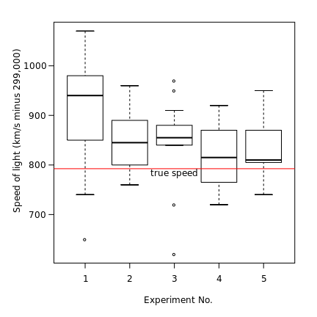
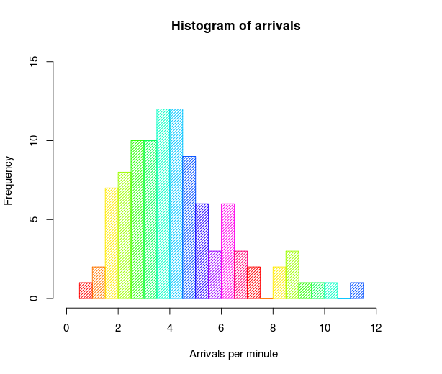
Typical graphical techniques used in EDA (examples)
Box plot
Histogram
Notes:
Box Plot: The box plot is a quick way of examining one or more sets of data graphically. Box plots may seem more primitive than a histogram or kernel density estimate but they do have some advantages. They take up less space and are therefore particularly useful for comparing distributions between several groups or sets of data. Choice of number and width of bins techniques can heavily influence the appearance of a histogram, and choice of bandwidth can heavily influence the appearance of a kernel density estimate.
Histogram: A histogram is a graphical representation of the distribution of data. It is an estimate of the probability distribution of a continuous variable (quantitative variable). A histogram can be thought of as a simplistic kernel density estimation, which uses a kernel to smooth frequencies over the bins. This yields a smoother probability density function, which will in general more accurately reflect distribution of the underlying variable. The density estimate could be plotted as an alternative to the histogram, and is usually drawn as a curve rather than a set of boxes.

Slide 16
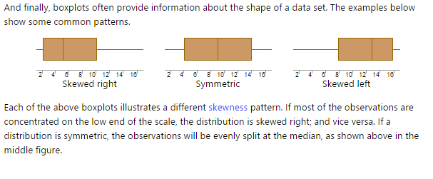
Box plot

Slide 17
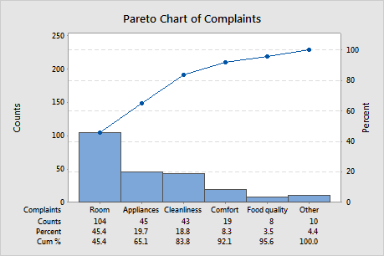
Typical graphical techniques used in EDA Pareto Chart
A Pareto chart is a special type of bar chart where the plotted values are arranged from largest to smallest. Use a Pareto chart to identify the most frequently occurring defects, the most common causes of defects, or the most frequent causes of customer complaints.
Notes:
What is a Pareto Chart (.. Cont)
The Pareto chart is named for Vilfredo Pareto and his principle of the "80/20 rule." That is, 20% of the people contain 80% of the wealth; or 20% of the product line may generate 80% of the waste; or 20% of the customers may generate 80% of the complaints, and so on.
Example of a Pareto chart
A manager wants to investigate causes of customer dissatisfaction at a particular hotel location. The manager investigates and records reasons for customer complaints.
Usually the left y-axis is frequency of occurrence, and the right y-axis is the cumulative percentage of the total number of occurrences. The x-axis displays the categories of defects, complaints, waste, and so on.

Slide 18
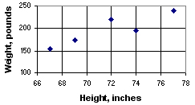
Typical graphical techniques used in EDA Scatterplot
A scatterplot consists of an X axis (the horizontal axis), a Y axis (the vertical axis), and a series of dots. Each dot on the scatterplot represents one observation from a data set. The position of the dot on the scatterplot represents its X and Y values.
Let's work through an example. Below, on the left, a table shows the height and the weight of five starters on a high school basketball team. On the right, the same data are displayed in a scatterplot.
Height, inches | Weight, pounds
67 | 155
72 | 220
77 | 240
74 | 195
69 | 175
Notes:
Each player in the table is represented by a dot on the scatterplot. The first dot, for example, represents the shortest, lightest player. From the scale on the X axis, you see that the shortest player is 67 inches tall; and from the scale on the Y axis, you see that he/she weighs 155 pounds. In a similar way, you can read the height and weight of every other player represented on the scatterplot.
Patterns of Data in Scatterplots
Scatterplots are used to analyze patterns in bivariate data. These patterns are described in terms of linearity, slope, and strength.
-Linearity refers to whether a data pattern is linear (straight) or nonlinear (curved).
-Slope refers to the direction of change in variable Y when variable X gets bigger. If variable Y also gets bigger, the slope is positive; but if variable Y gets smaller, the slope is negative.
-Strength refers to the degree of "scatter" in the plot. If the dots are widely spread, the relationship between variables is weak. If the dots are concentrated around a line, the relationship is strong.

Slide 19
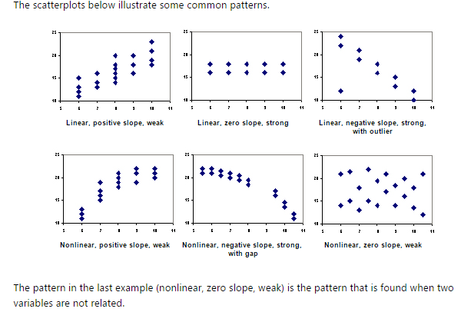
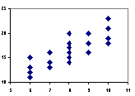
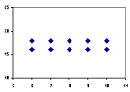
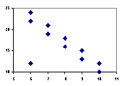
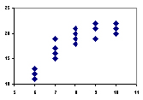
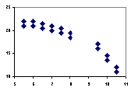
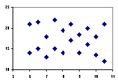

Slide 20
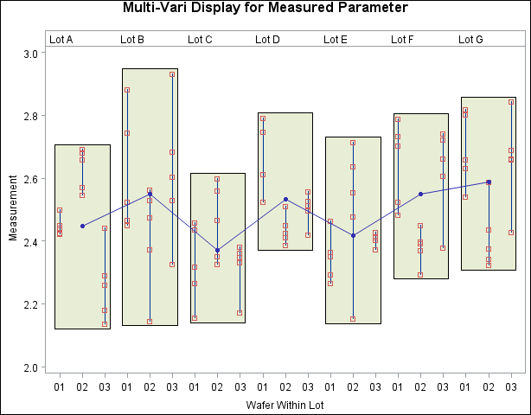
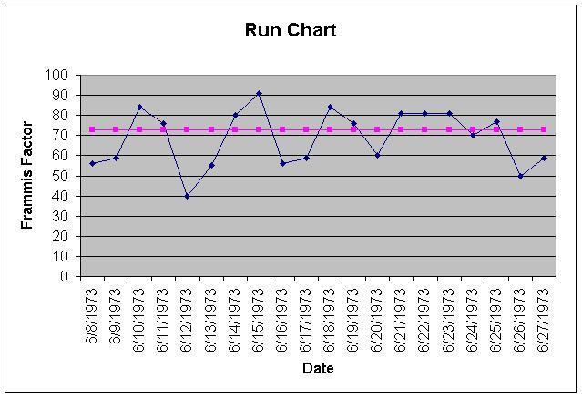
Typical graphical techniques used in EDA (cont.)
Multi-vari chart
Run chart
Notes:
Multi-vari and run-charts are used to analyse deviations from the standard or control variable.
Typically used in production or factory environments.

Slide 21

Focus of this course
Use of R tools
Non-GUI based
Gain “superpowers” to handle your data
Two graphical techniques using R
Histograms (For 1 variable or univariate)
Scatterplots (For 2 variable or bivariate)
Become a superhero, handle your data with R
http://cierareports.org/blog/2013/10/18/rCourse2013/

Slide 22
Install R
R is a programming language for Data Science / Data Analytics
http://www.r-project.org/
Software is free
Windows, Mac OSX, and Linux are supported

Slide 23
Install R Studio
This provides an Integrated Development Environment (IDE) for editing, debugging, and testing
http://www.rstudio.com/
Software is free
Windows, Mac OSX, and Linux are supported

Slide 24
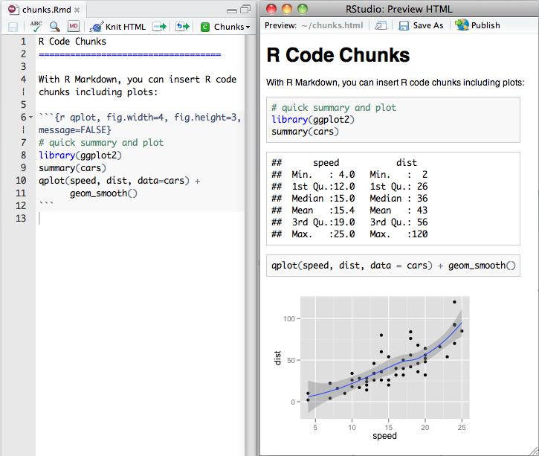
R Markdown (.Rmd)
R Markdown is way to write quick attractive reports that use R output. You write the reports in a markdown document, inserting R code where you like it (left).
http://rmarkdown.rstudio.com/

Slide 25
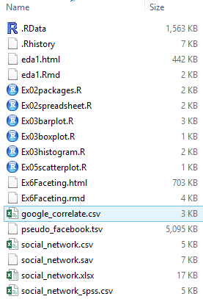
Try the following example
Install R and R Studio on your laptop
Unzip eda.zip file
List of files in eda2 data sets are
as show ->

Slide 26
Using R Studio
Reading from a spreadsheet
Managing and installing packages

Slide 27
Reading from spreadsheet
Save the spreadsheet file (.xlsx) as a csv file on the desktop
Use the read.csv() function to read the csv file.
Note the use of forward slash “/” as file path separators
# read social_network.csv file into a data frame sn.csv
# we assume that the social_network.csv file is in D drive
sn.csv <- read.csv(“D:/ed2 data sets/social_network.csv", header = T)
# to view the variables and no of observations
#(NB: Console panel)
> str(sn.csv)

Slide 28
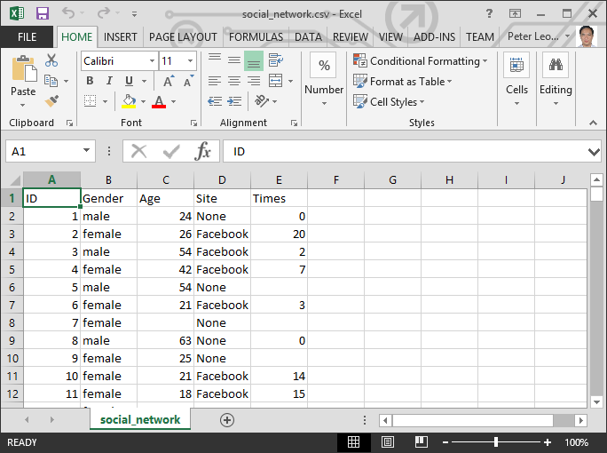

Slide 29
Exploring single variables (univariate) Data file: galaxies.csv
Histogram
Boxplot

Slide 30
Histograms
For single variable data sets, the histogram allows us to see if there are natural clusters, or groups of information.
Multi-modality or multiple peaks in the histogram
How many “clusters”

Slide 31
Write R code
#read a csv file into galaxy.csv
galaxy.csv <- read.csv(“D:\eda2 data sets\galaxies.csv, header = T)
#view the no of variables and observations
# Console panel. Key in str(galaxy.csv)
> str (galaxy.csv)
Notes:
A galaxy is a collection of stars and planets that are held together by gravity. The distance between stars is measured in km/s

Slide 32
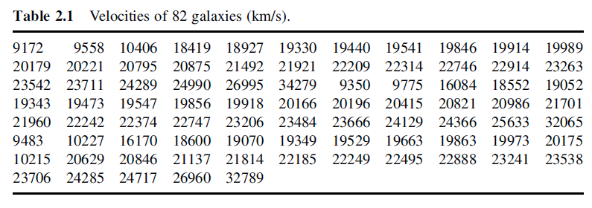
Notes:
Data from galaxies.csv.

Slide 33
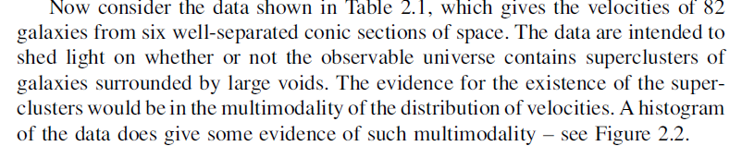

Slide 34
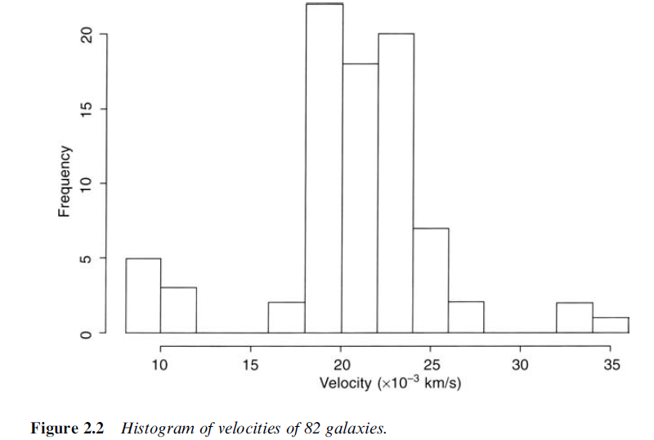
Notes:
There are 3 clusters. One cluster has velocity of between (0 to 12 10⁻³ km/s, 2nd cluster has velocity of between (16 to 28)10⁻³ and 3rd cluster has velocity of between (32 to 36 )10⁻³km/s

Slide 35
Once the data are entered into R, the first task in any analysis is to examine the individual variables. Now, the purpose of this task are threefold:
first, to check that the data were entered correctly;
second, to check whether the data meet the assumptions of the statistical procedures that you've planned to use; and
third, to check for any potentially interesting, or informative observations, or patterns in the data.

Slide 36
For a categorical variable, such as a respondent's gender, or a company's economic sector, that is, a nominal or an ordinal variable, the easiest and most informative way to check the data is to make a bar chart.

Slide 37
Reading from spreadsheet (from earlier step/slide)
Save the spreadsheet file (.xlsx) as a csv file on the desktop
Use the read.csv() function to read the csv file.
Note the use of forward slash “/” as file path separators
# read social_network.csv file into a data frame sn.csv
# we assume that the social_network.csv file is in D drive
sn.csv <- read.csv(“D:/eda2 data set/social_network.csv", header = T)
# key in the console panel
str(sn.csv)

Slide 38
Creating a Bar Chart from categorical variables
# R doesn't create bar charts directly from the categorical
# variables; instead, we must first create a table that
# has the frequencies for each level of the variable.
# The "table" function is able to create this table from
# the variable, which we specify as sn.csv$Site.
site.freq <- table(sn.csv$Site) # Creates table from Site
site.freq # displays the table in the Console
barplot(site.freq) # Creates barplot in new window

Slide 39
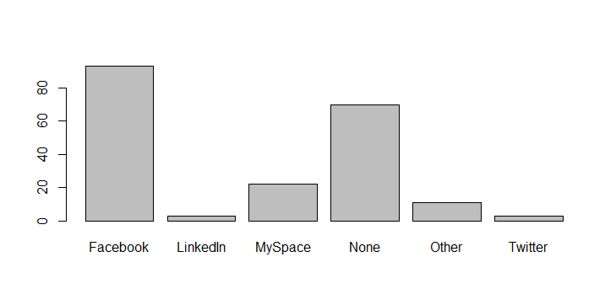

Slide 40
Creating a Bar chart from quantitative variables
# Make a histogram of Age using the defaults
hist(sn.csv$Age)
# Add title, colors, etc.
hist(sn.csv$Age,
col = "beige", # Or use: col = colors() [18]
main = "Ages of Respondents\nSocial Networking Survey of 202 Users",
xlab = "Age of Respondents")

Slide 41
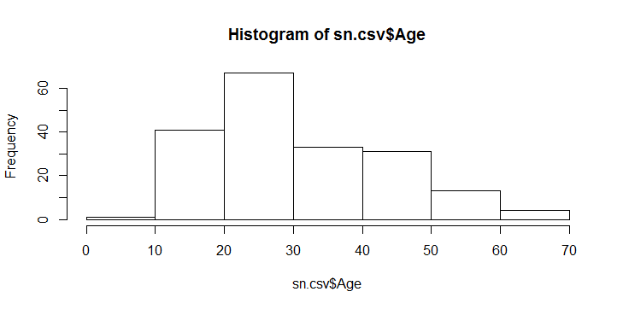

Slide 42
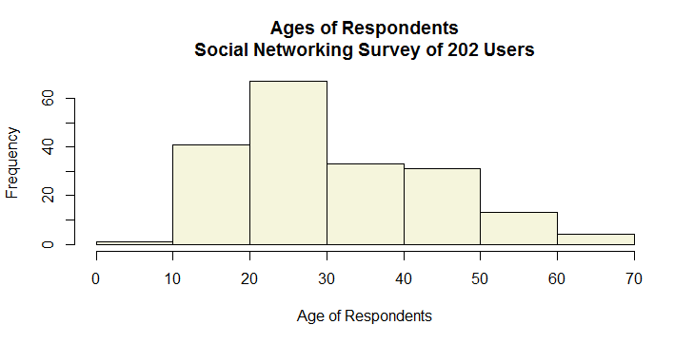

Slide 43
Creating a Boxplot from quantitative variables
# Make boxplots of Age and Times using the defaults
boxplot(sn.csv$Age)
# Add title, colors, etc.
boxplot(sn.csv$Age,
col = "beige",
notch = T,
horizontal = T,
main = "Ages of Respondents\nSocial Networking Survey of 202 Users",
xlab = "Age of Respondents")

Slide 44
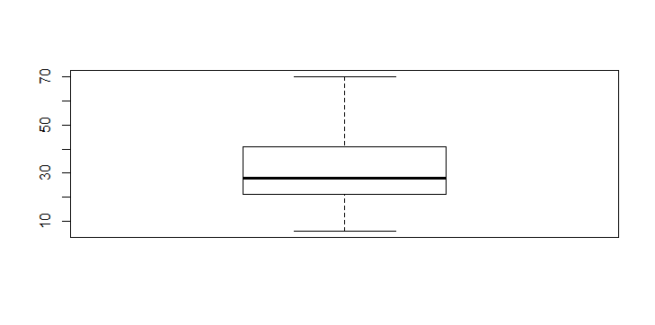

Slide 45
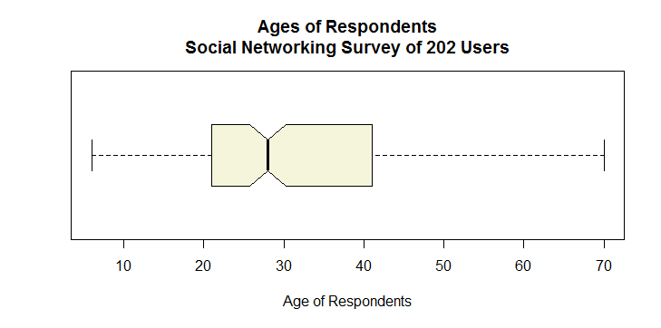

Slide 46
Exploring multiple variables
Scatter Plot Matrix
Scatter Plot
Regression

Slide 47
Scatterplot Matrix
When we explore a new data set, often times we don’t know which variables are related or unrelated to each other.
A scatterplot matrix is a quick graphical way to explore the relationships that exists within the variables a data set

Slide 48
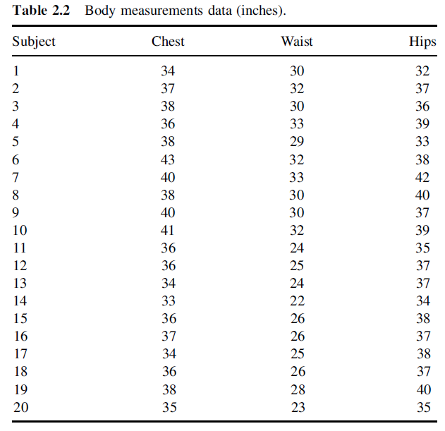

Slide 49
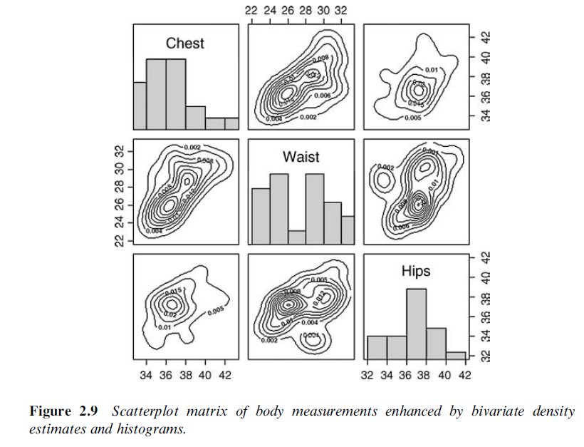

Slide 50
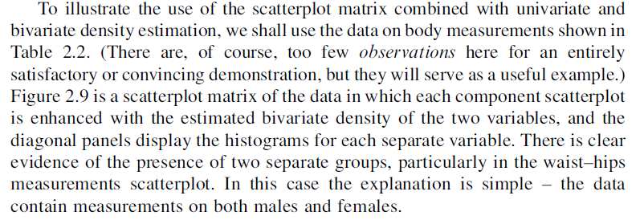

Slide 51
Scatterplot matrix using R
In R the command is simple, it is just plot()
Try using some of the built-in data sets such as iris and mtcars. Enter the following in the R console
plot(iris)
plot(mtcars)

Slide 52
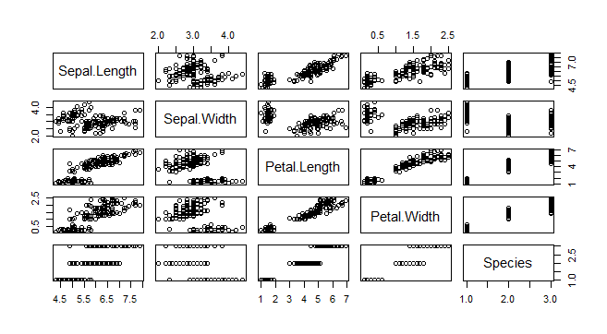

Slide 53
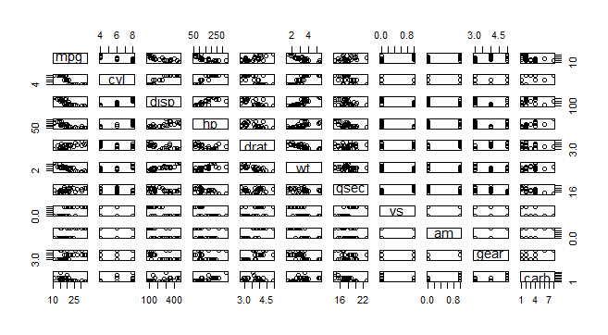

Slide 54
Scatter Plot
# Load data file about Google searches by state
google <- read.csv("google_correlate.csv", header = T)
names(google)
str(google)
# Is there an association between the percentage of people
# in a state with college degrees and interest in
# data visualization?
plot(google$degree, google$data_viz)

Slide 55
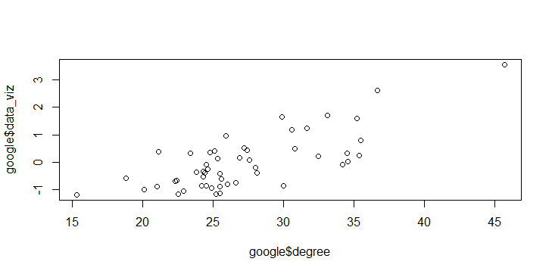

Slide 56
Regression
# Add title, labels, change circles to points
plot(google$degree, google$data_viz,
main = "Interest in Data Visualization Searches\nby Percent of Population with College Degrees",
xlab = "Population with College Degrees",
ylab = "Searches for \"Data Visualization\"",
pch = 20,
col = "grey")
# Add fit lines
# Linear regression line (y ~ x)
abline(lm(google$data_viz ~ google$degree), col="red")
# Lowess smoother line (x, y)
lines(lowess(google$degree, google$data_viz), col="blue")

Slide 57
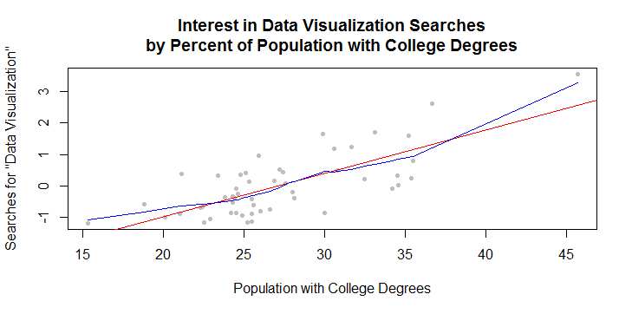

Slide 58
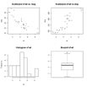
Description: Par()
Combining Plots
R makes it easy to combine multiple plots into one overall graph, using either the par( ) or layout( ) function.
With the par( ) function, you can include the option mfrow=c(nrows, ncols) to create a matrix of nrows x ncols plots that are filled in by row. mfcol=c(nrows, ncols) fills in the matrix by columns.
# 4 figures arranged in 2 rows and 2 columns attach(mtcars) par(mfrow=c(2,2)) plot(wt,mpg, main="Scatterplot of wt vs. mpg") plot(wt,disp, main="Scatterplot of wt vs disp") hist(wt, main="Histogram of wt") boxplot(wt, main="Boxplot of wt")

Slide 59
Description: Rug command
Adds a rug representation (1-d plot) of the data to the plot.
Usage
rug(x, ticksize = 0.03, side = 1, lwd = 0.5, col = par("fg"), quiet = getOption("warn") < 0, ...)
Example:
>Rug(df[[1]], col = “red”)
File name is df
Rug means – represent data in red color

Slide 60
Summary of commands
1 | Command | Description
2 | barplot()
3 | hist()
4 | Main
5 | xlab
6 | boxplot()
7 | Names()
8 | Str()
9 | Plot()

Slide 61
END

